Slide 1
Overcoming catastrophic forgetting with Orthogonal Update in Continual Learning
汇报者：章涵
Notes:
老师们同学们大家好，在座的各位想必有许多都十分喜欢音乐，而近年来中国风歌曲的发展也是有目共睹的，我们组的研究主题是中国风歌词的文化特性与发展情况

Slide 2
1
Introduction
2
Orthogonal Update
3
Experiment
4
Conclusion

Slide 3
Introduction
Continual Learning(CL) is a concept to learn a model for a large number of tasks sequentially without forgetting knowledge obtained from the preceding tasks, where the data in the old tasks are not available any more during training new ones. The goal of CL is achieving two main objectives: overcoming catastrophic forgetting (CF) and encourage knowledge transfer across tasks (KT).

Slide 4
Mainstream Approach in Continual Learning
1、Regularization
2、Ensembling
3、Replay

Slide 5
Different Type of Continual Learning
1、input formatting
2、similar tasks
3、dissimilar tasks

Slide 6
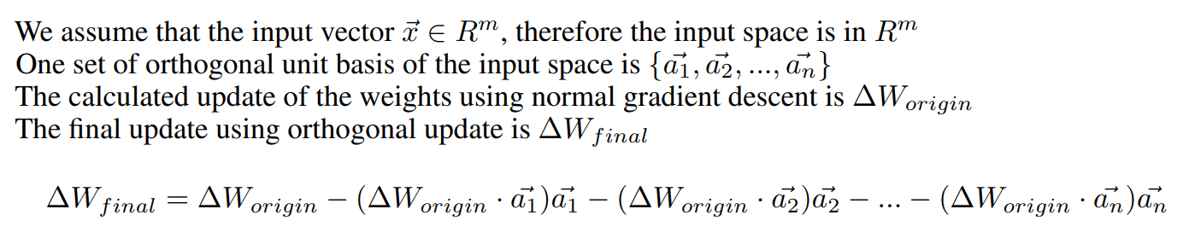
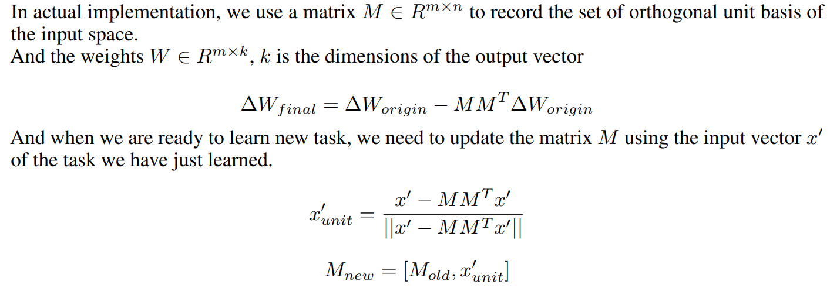
Orthogonal Update

Slide 7
Experiment
Dataset : MINST
Model : [784-800-10] neurons
Hyper-parameter : batch_num

Slide 8
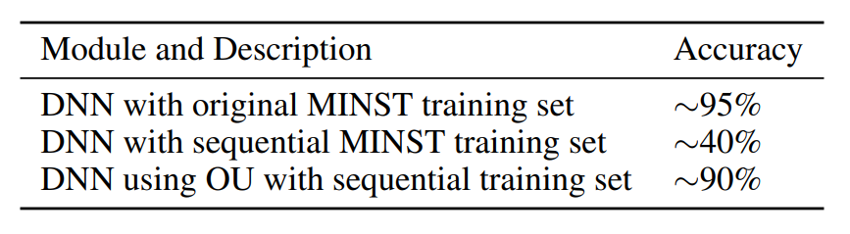
Result of the Experiment

Slide 9
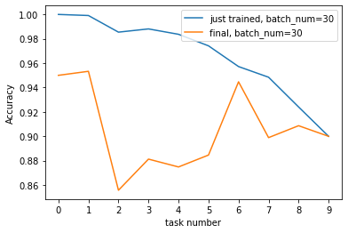
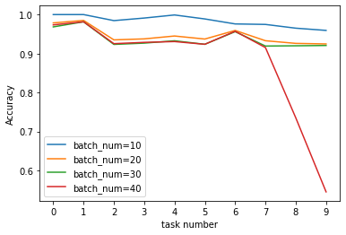
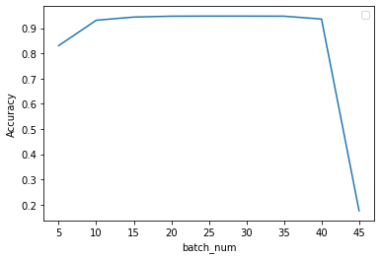
Result of the Experiment

Slide 10
Conclusion
The experiment shows that Orthogonal Update can greatly overcome the catastrophic forgetting, and the only hyper-parameter batch_num will affect the performance of the model and they are not monotonic relationship, so every time we need to select the best batch_num in order to reach best performance
Weakness of Orthogonal Update The weakness of the Orthogonal Update is that when the input vector’s dimensions is determined, the rank of the matrix M is at most the dimensions of the input vector. So as the task number increase, the subsequent task have more and more constraints, they are more and more hard to be learned.

Slide 11
Thanks!
Notes:
经过我们简要的分析，想必大家对中国风歌词增加了一定程度的认识，当然中国风歌词的发展需要我们共同关注和支持，只有我们的鉴赏水平日渐提高，其质量才能日益增长。感谢大家的倾听。

